Slide 1
Sprint Planning in Scrum
And how to do it without tearing your eyes out.

Slide 2
The Scrum Guide Says…
Scrum prescribes four, formal events for inspection and adaptation…:
Daily Scrum
Sprint Review
Sprint Retrospective
Sprint Planning

Slide 3
The Scrum Guide Says…
Q. What is planned at the Sprint Planning?
A. The work to be performed
Q. Who creates this plan?
A. The entire Scrum Team
Q. How long is it?
A. Eight hours for 30-day Sprint and usually less for shorter Sprints.

Slide 4
The Scrum Guide Says…
Sprint Planning answers two questions:
What can be delivered in the Increment resulting from the upcoming Sprint?
How will the work needed to deliver the Increment be achieved?

Slide 5
The Scrum Guide Says…
What can be delivered in the Increment resulting from the upcoming Sprint?
The Development Team works to forecast the functionality that will be developed during the Sprint.
The Product Owner discusses the objective that the Sprint should achieve and the Product Backlog items that, if completed in the Sprint, would achieve the Sprint Goal

Slide 6
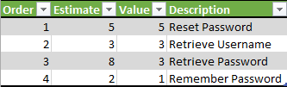
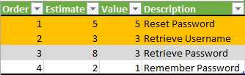
Sprint Planning Example
The Development Team says:
The Product Owner says:
Based on our historical velocity of 30 and considering that Bill is out this Sprint, we forecast we can develop these next PBI’s this Sprint.
These two PBI’s will accomplish the objective of reducing support’s time spent resetting user passwords. The Scrum Team decides the Sprint Goal should be:
Automatic Login Credential Recovery

Slide 7
The Scrum Guide Says…
How will the work needed to deliver the Increment be achieved?
The Development Team decides how it will build this functionality into a “Done” product Increment during the Sprint.
The Product Owner can help clarify the selected Product Backlog items and make trade-offs.

Slide 8
The Scrum Guide Says…
How will the work needed to deliver the Increment be achieved?
By the end of the Sprint Planning, the Development Team should be able to explain to the Product Owner and Scrum Master how it intends to work as a self-organizing team to accomplish the Sprint Goal and create the anticipated Increment.

Slide 9
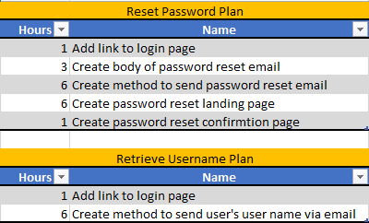
Sprint Planning Example
The Development Team has planned for the first days of the Sprint by decomposing the work into units of one day or less.
Though not specified by Scrum, the Development Team likes small units of work to minimize the risk of weak estimation practices.

Slide 10
Quick Review
Q. Who works to forecast the functionality that will be developed during the Sprint?
A. The Development Team

Slide 11
Quick Review
Q. What is planned at the Sprint Planning?
A. The work to be performed
Q. Who creates this plan?
A. The entire Scrum Team
Q. How long is it?
A. Eight hours for 30-day Sprint and usually less for shorter Sprints.

Slide 12
Quick Review
Q. Who crafts the Sprint Goal?
A. The entire Scrum Team

Slide 13
Quick Review
Q. What 3 inputs does the Development Team use to forecast the functionality that will be developed during the Sprint?
A1. The Product Backlog
A2. The Development Team’s past performance
A3. The Development Team’s projected capacity

Slide 14
Quotations Set the Stage
“What are you preparing. You’re always preparing. Just go!” – Dark Helmet, Space Balls 1987
“An ounce of prevention is worth a pound of cure.” – My Mom, Every Time I Had to Clean My Room
“Just a spoonful of sugar makes the medicine go down in the most delightful way!” – My personal life coach, Mary Poppins

Slide 15



Don’t Tear Your Eyes Out!
You mean we wasted 4 hours designing a new email subsystem when one already exists?
What do you mean there are no acceptance criteria on the next 20 User Stories?
I’ve been staring at a monitor for 3 hours. Where’s my sippy cup?!

Slide 16
Refine that Backlog
Set aside focused time to understand the Product Backlog.
Craft just enough, just in time.
Stagger Refinement for maximum, “cognitive stewing” without impeding.

Slide 17
Anticipate Challenges
Lack of cross-functionality for work
Customer collaboration e.g. requirement questions
Reduced capacity

Slide 18
Keep it Fresh
Take frequent breaks if needed
Encourage all to participate actively
Change the format to engage the mind differently
Provide fizzy beverages

Slide 19

Let’ Taco ‘bout It

Slide 20

Happy Planning!

